Slide 1







GROUP 4
Adventure
Works Cycle

Slide 2

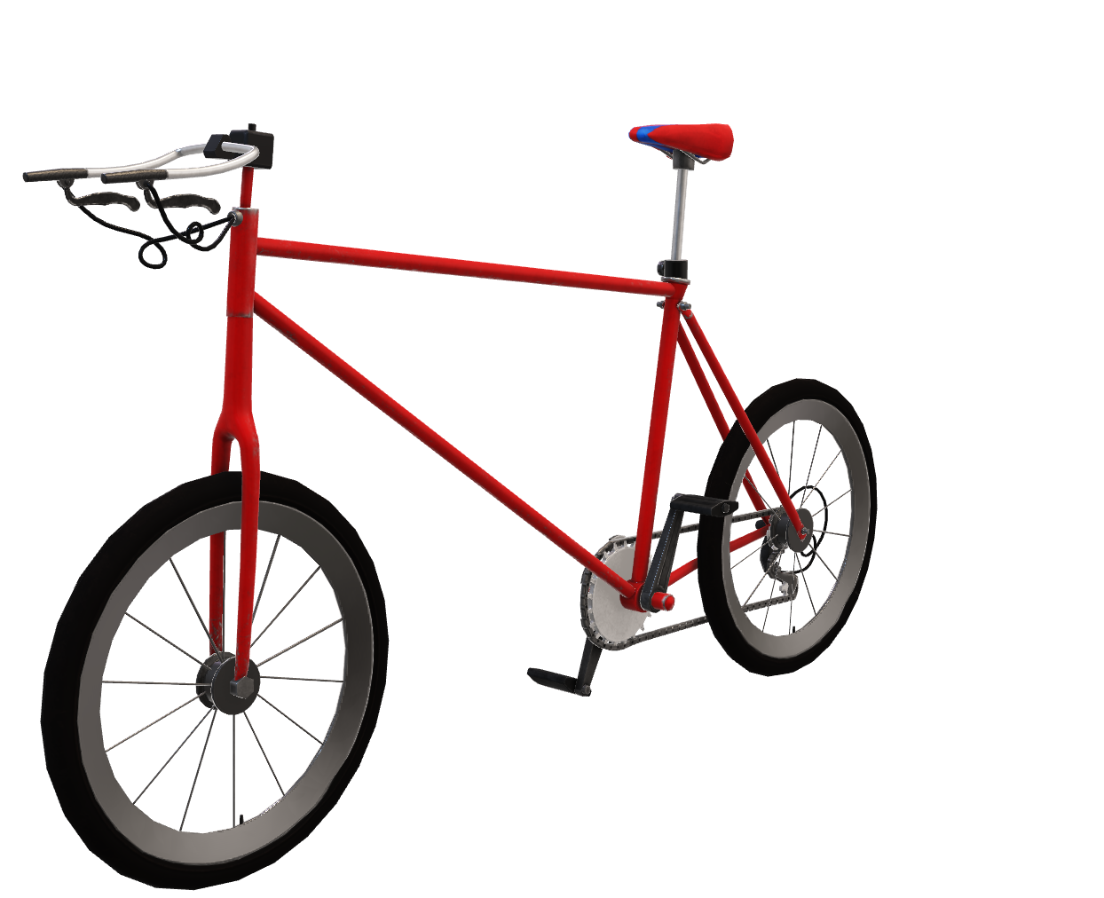
Introduction
About Company
Adventure Works Cycles sells metal and composite bicycles globally, with a base in Washington and a manufacturing plant in Mexico. They aim to expand their market share by targeting customers, extending availability, and reducing costs.
An overview –
The presentation contains business scope, conclusion and the connection of dataset.

Slide 3



Table of Contents
Business Scope
Data Model
Conclusion
Sales analysis, customer insights, product assessment.
Adventure works data set, data connection overview
Briefly elaborate on what you want to discuss.

Slide 4




Business Scope
sales analysis –
gave us an insight from year 2010 – 2014 year ; 2013 year being the most profitable followed by 2012 and 2011 lowest sales were detected in 2010 & 2014.
In terms of sales we can see there's an immense surge up in the month of December of every year.

Slide 5



Business Scope
Customer analysis
Market analysis
Customer segment between age 25 -35 are our main segment as in of 4 years of statistical data. Mountain bike being the best seller product
Geographical analysis
. Promotional ads helped mostly in the European area followed by Australia and USA
Area-wise Europe Australia, USA, Germany are giving us profit.

Slide 6
Data Model
Product
Union Table
(Fact Table)
Product Category
Sales Territory
Customer
Date

Slide 7
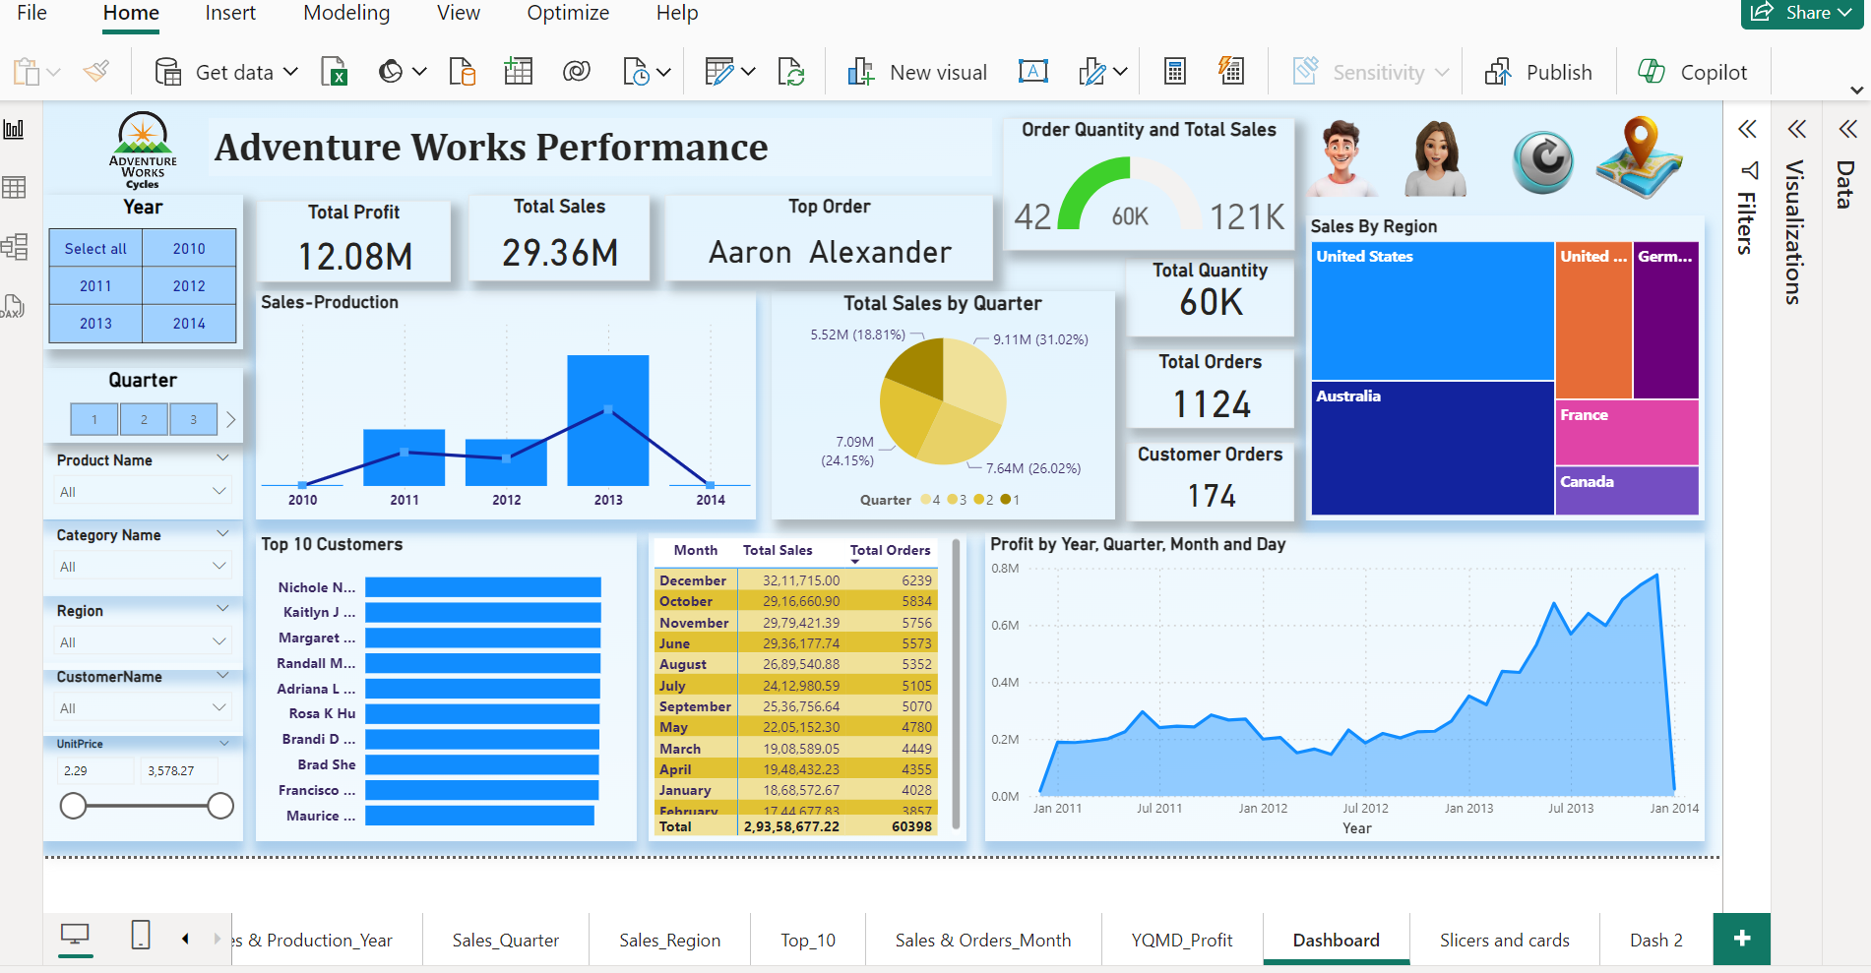
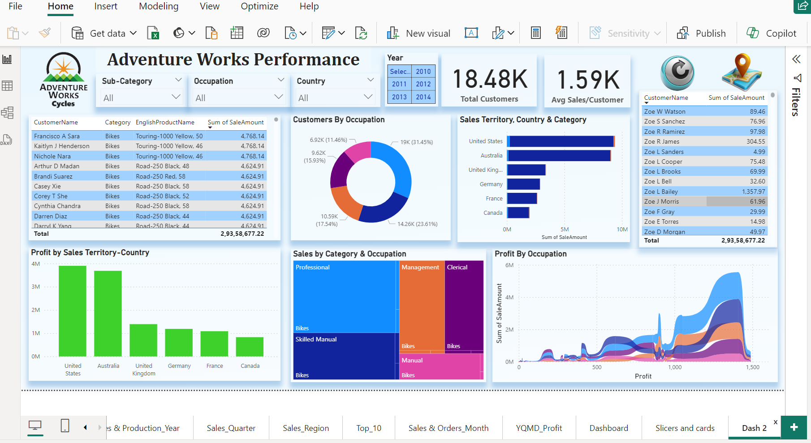
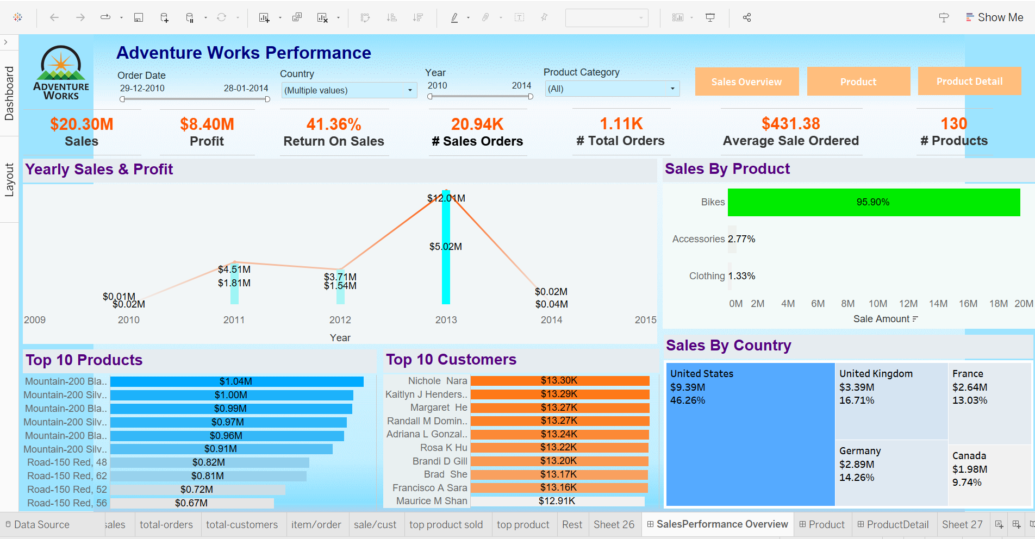
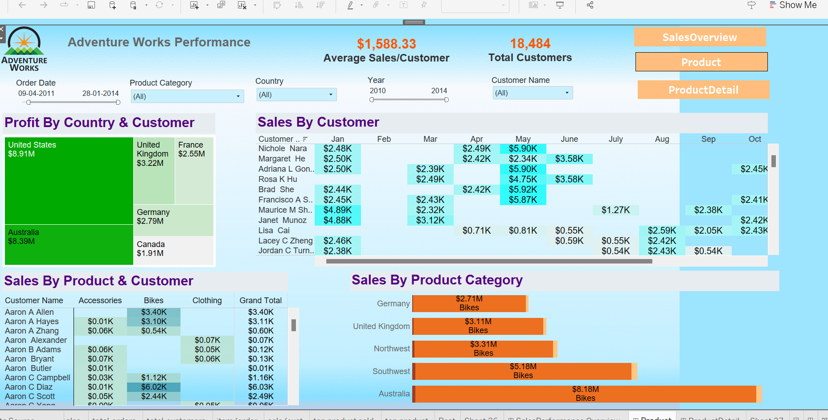
Dashboard

Slide 8
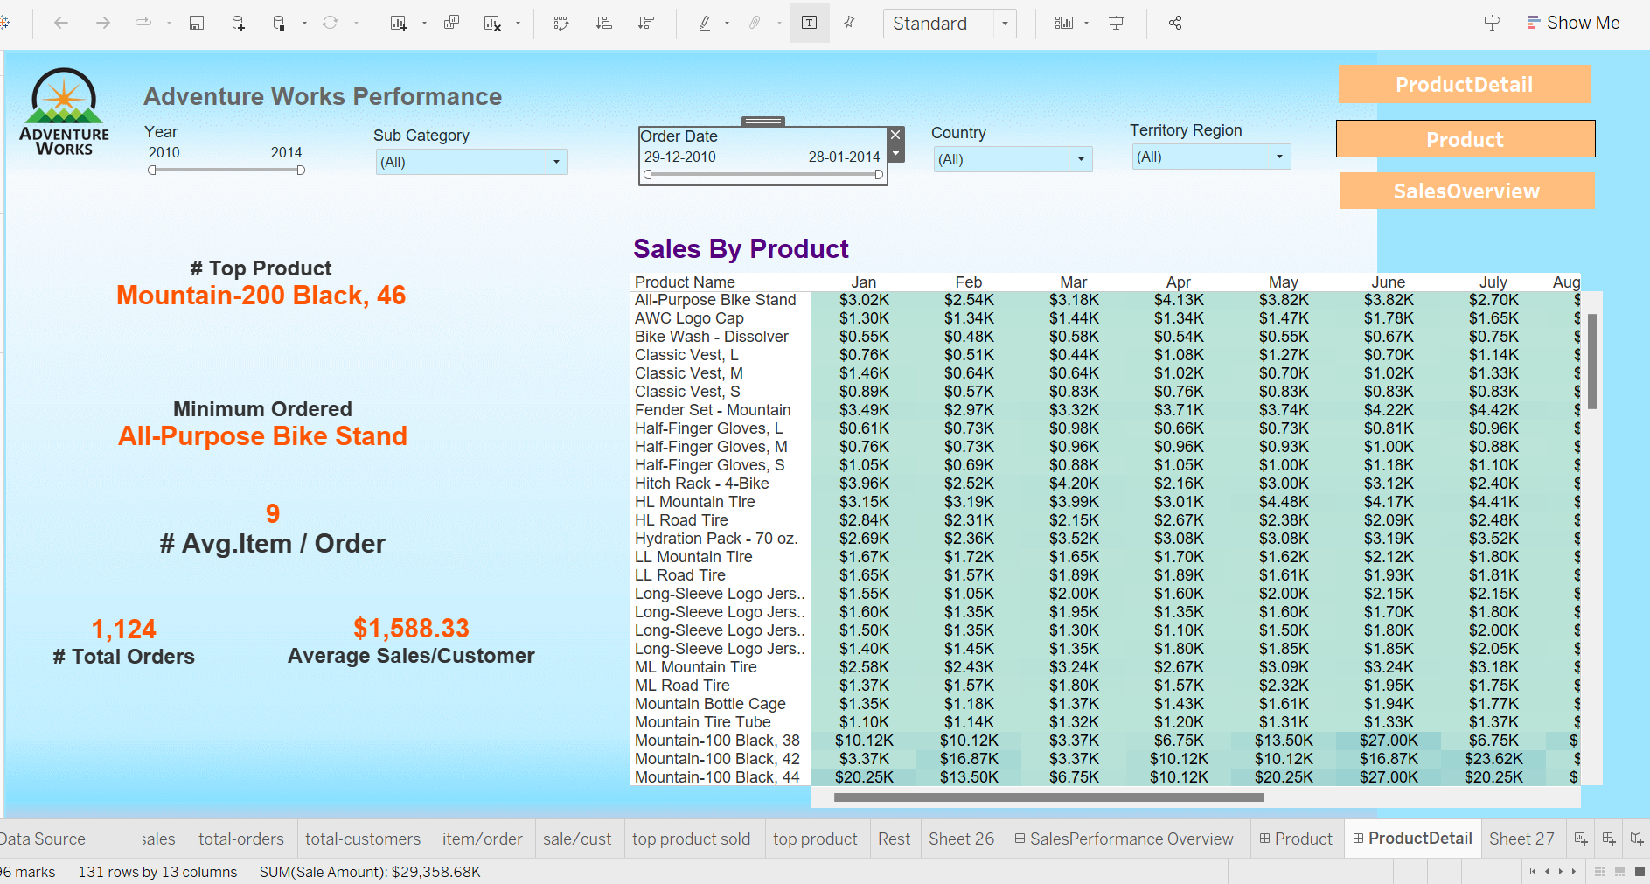
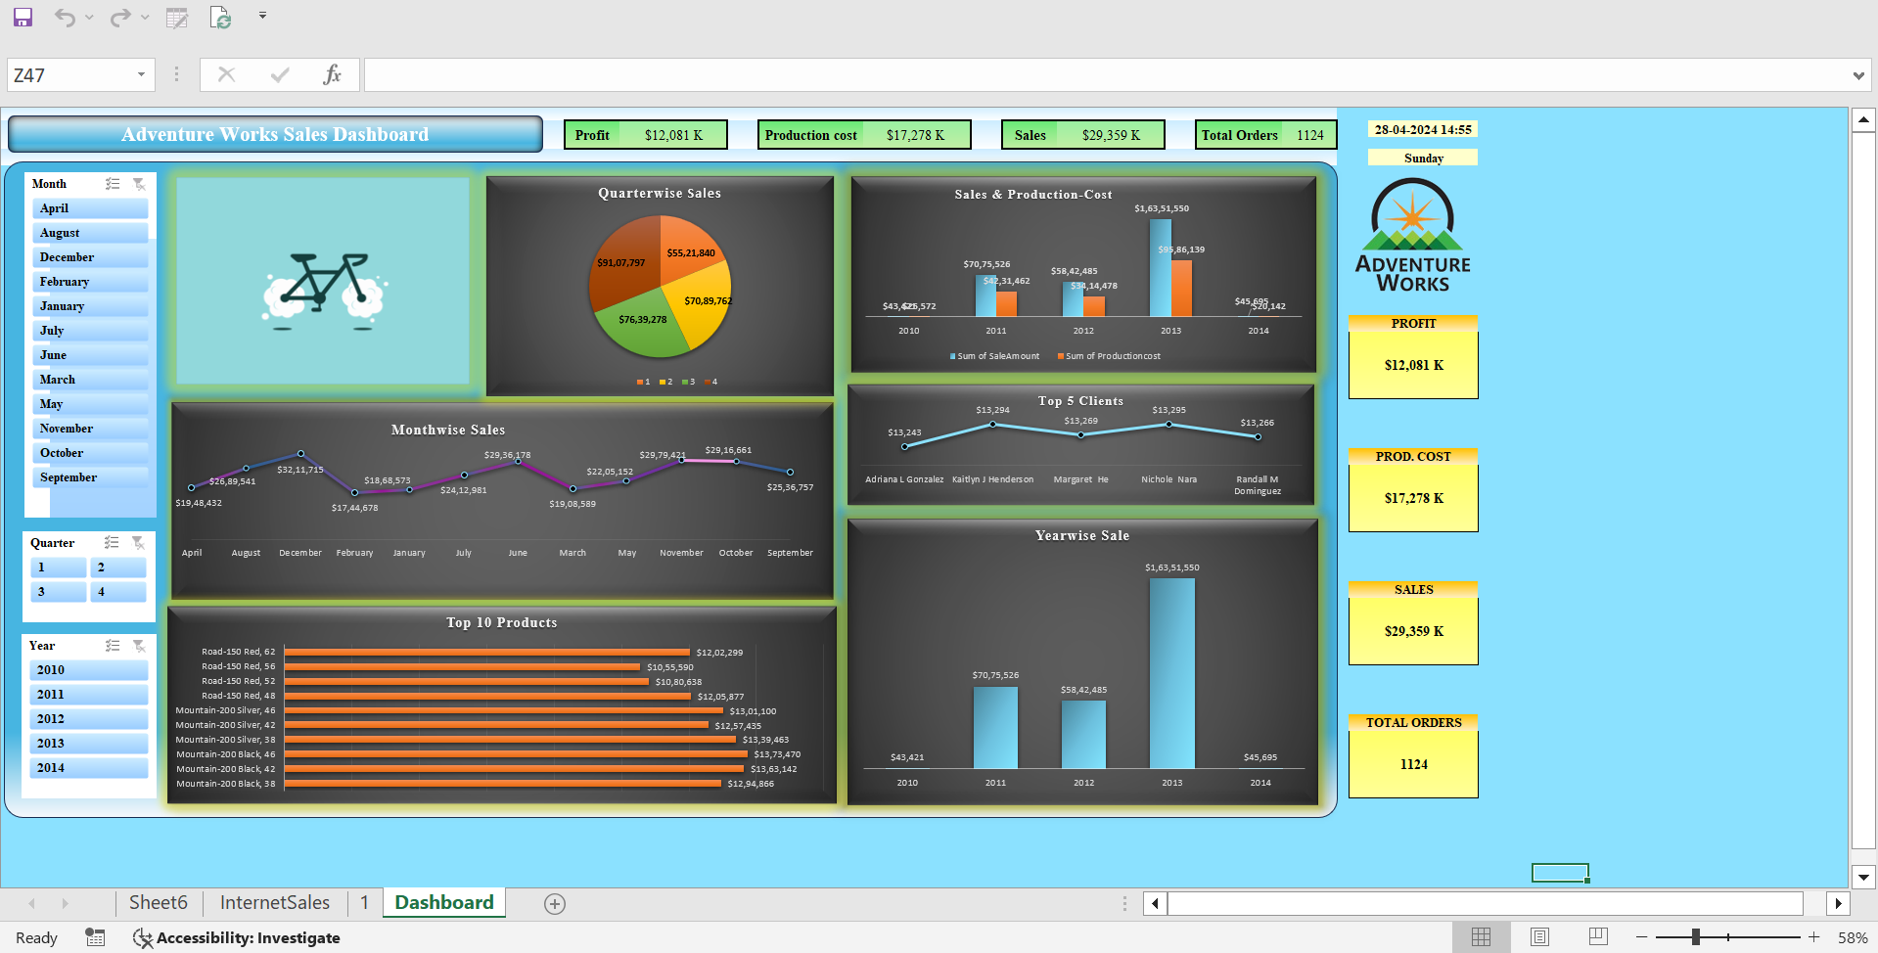
Dashboard

Slide 9
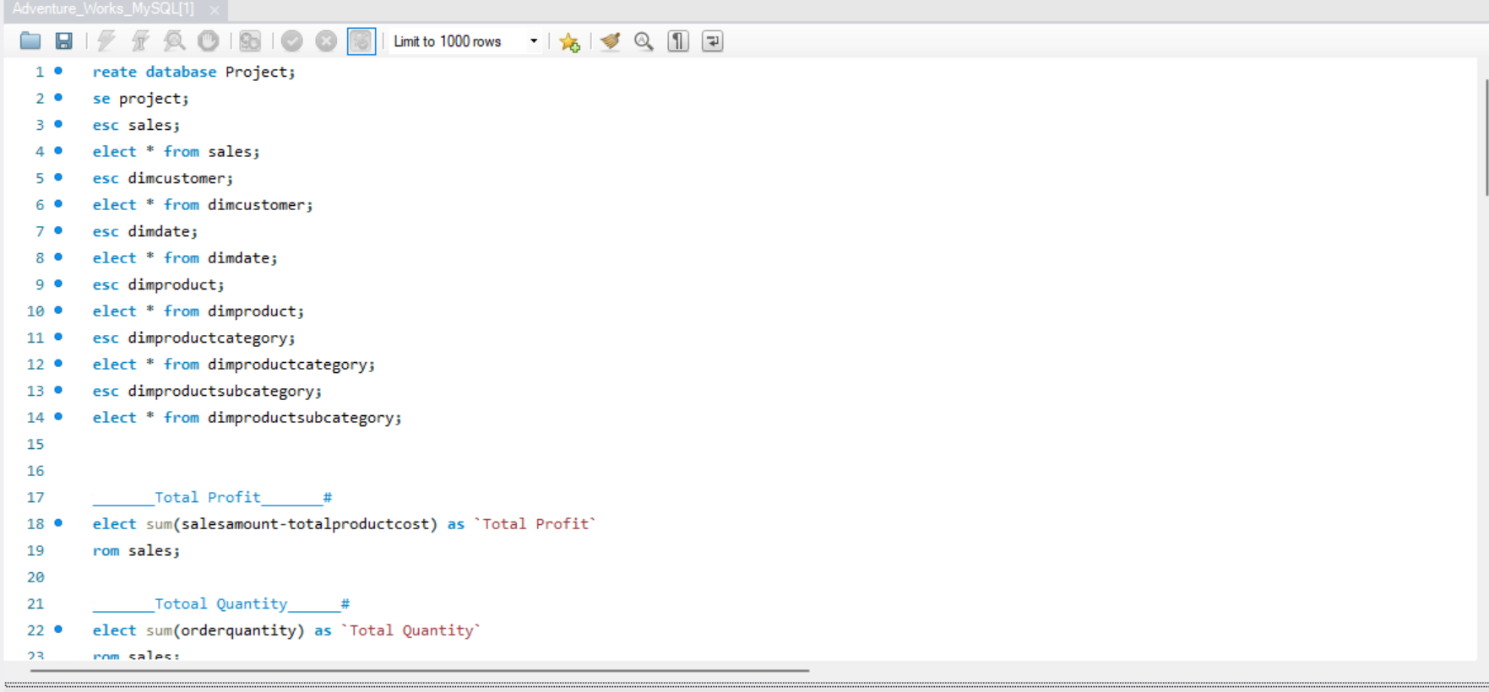
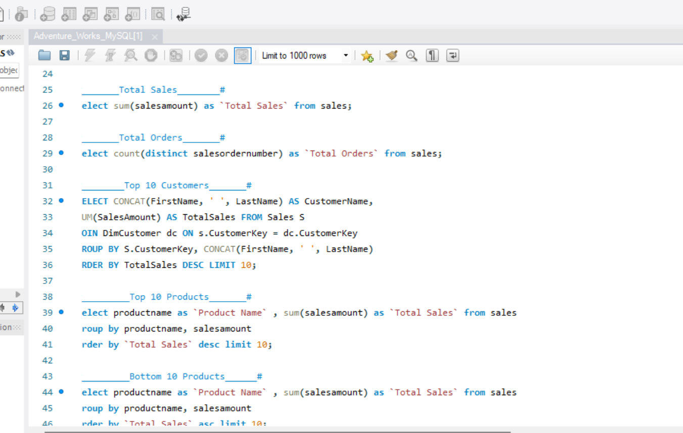
SQL Querry

Slide 10
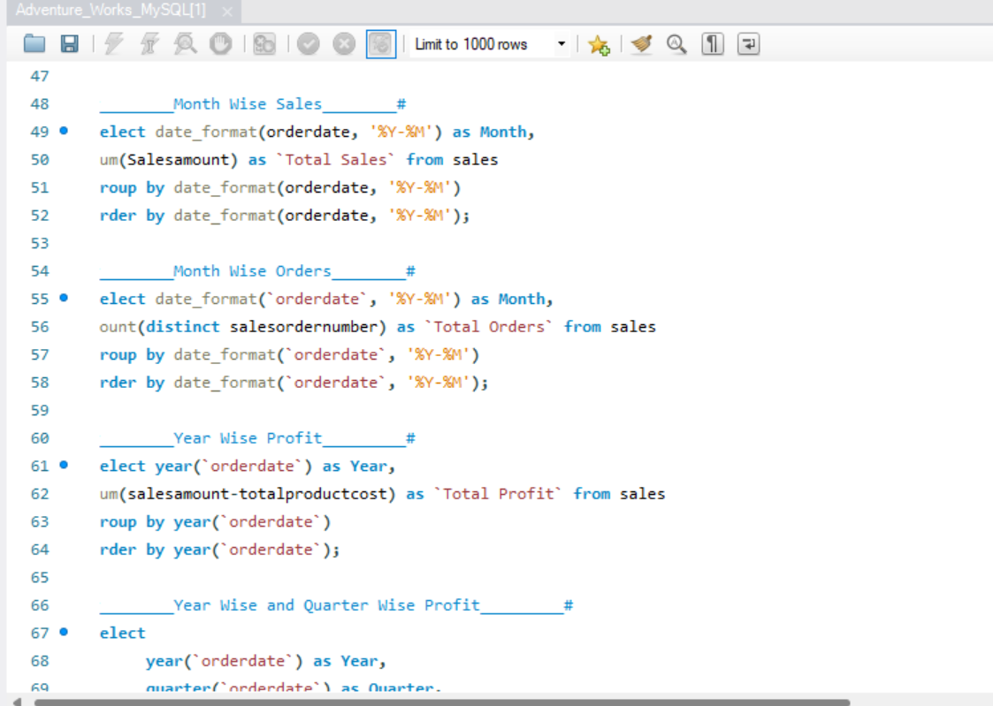
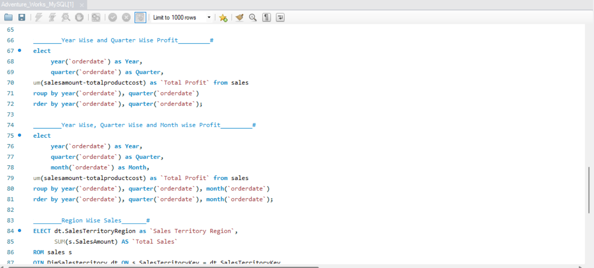
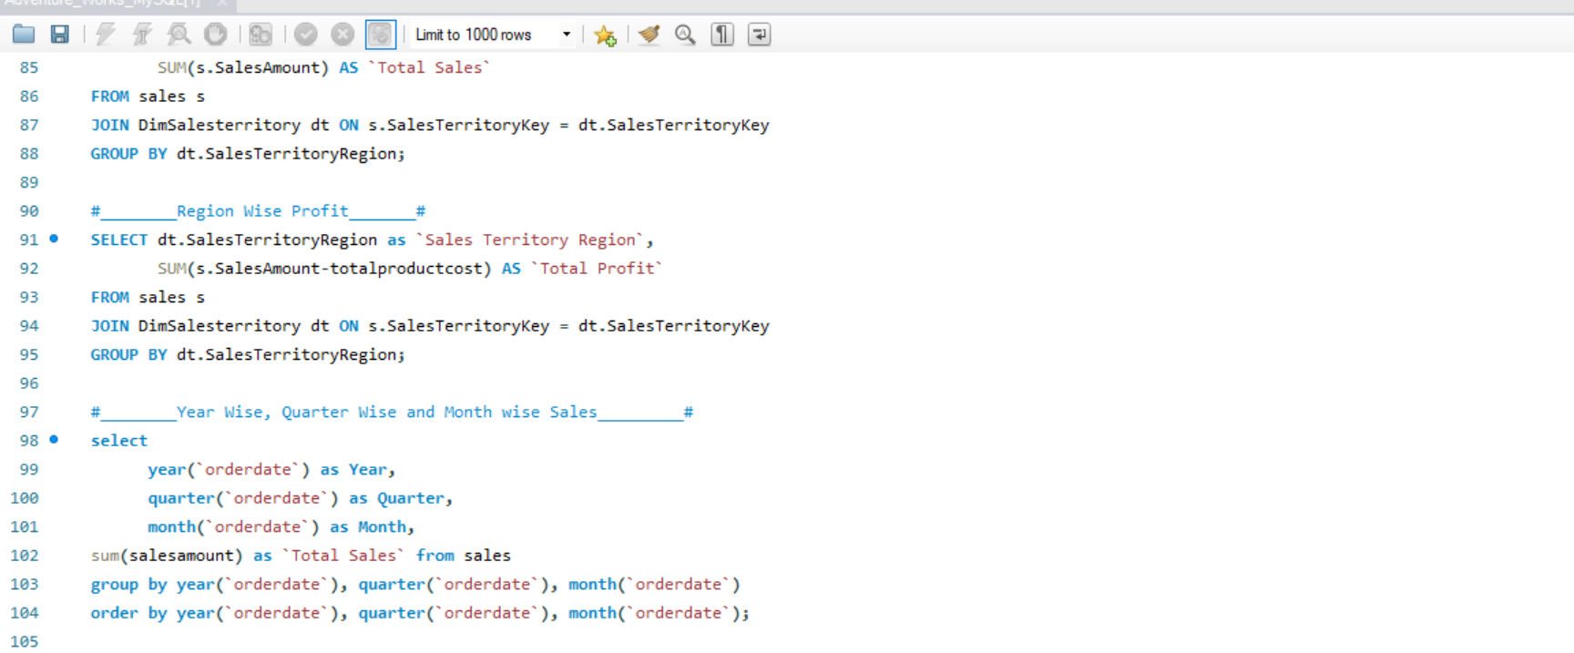
SQL Querry

Slide 11
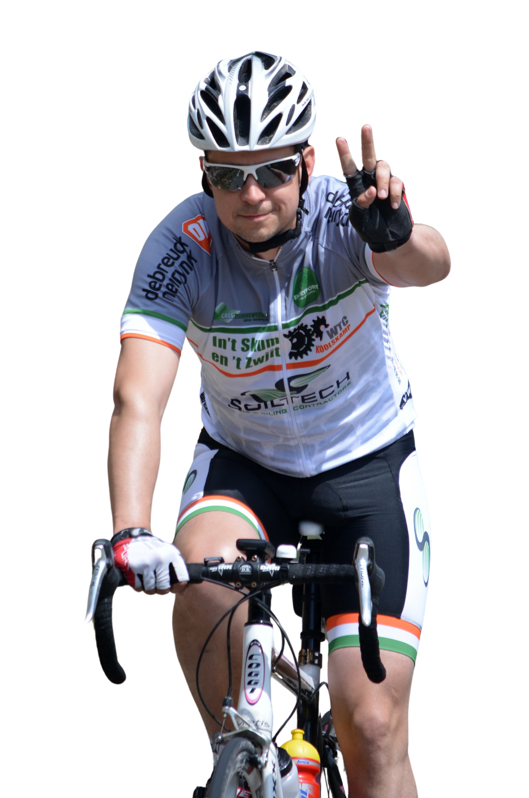
Conclusion
Most profitable sales were recorded in December 2013,sales promotions allowed generating more revenue. Whereas sales performance was low at the beginning of every year.
The number of customer orders frequency who make one, two or three order purchases and so on; 13K out of 15K customers have made only 1-time purchase
In conclusion AWC the analysis revealed insights sales performance, customer analysis and market and product analysis..
In conclusion , the analytics showed us the surge up performance of sales during the promotional period. European market being the main market whereas the 2nd being the USA.
AWC needs to include more coupons, promotional adverts.
In bike product mountain-200 black product being the top seller.

Slide 12
Remonstration
Focus on bikes priced between $1000 and $2320 and diversify offerings within this range through value engineering.
Discontinue production of red-colored bikes due to declining sales and prioritize colors showing market growth.
Replicate the success of the Road 750 Black series by introducing similar bikes in yellow and silver.
Expand color options for the Road-250 Red series to align with customer preferences and boost sales.
Recommend offering weekend discounts to boost sales, as weekend foot traffic is lower, with Tuesday eminent as the peak selling day in 2013.

Slide 13
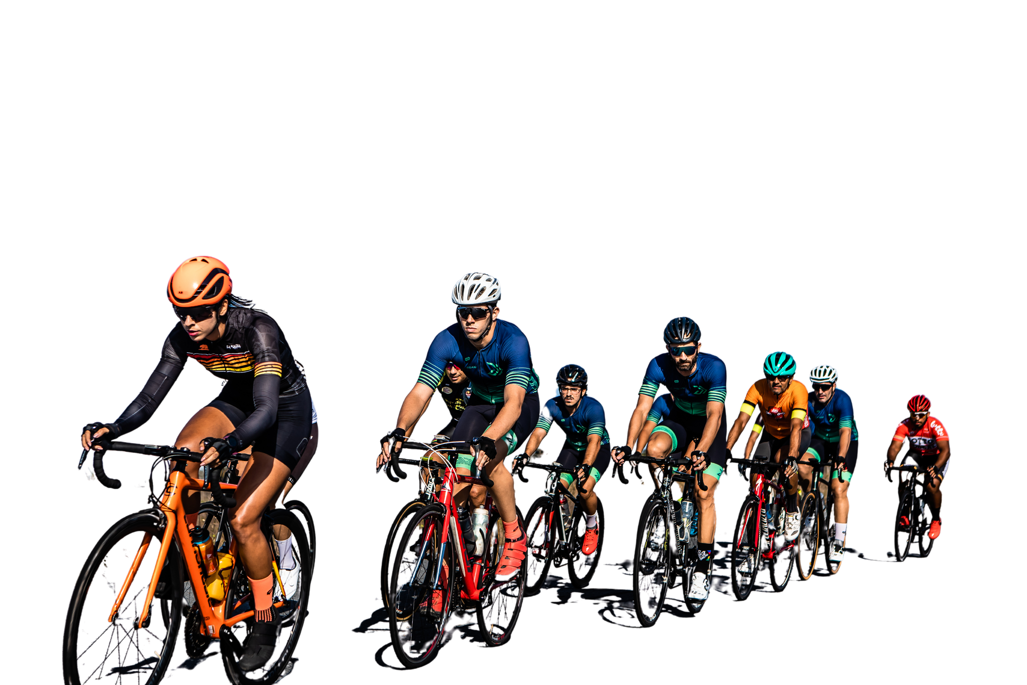
Team Members
Shanmukh Anand
Riyas K Aboobacker
Ajinkya S Kharat
Monika R Mahajan
Priti S Waghmare
Mrunalini S Bhorde
Bhushra

Slide 14
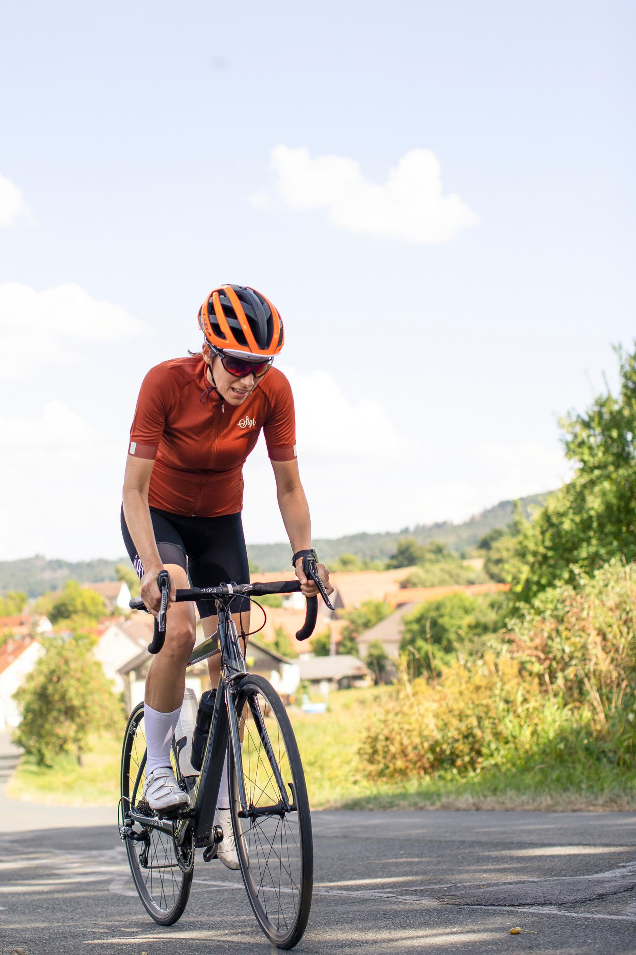
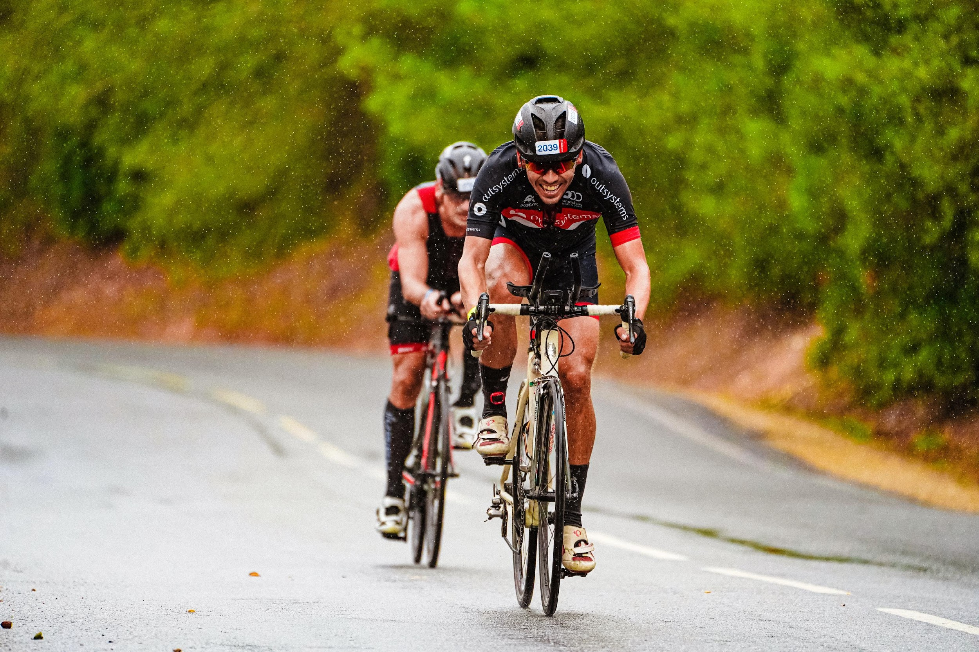
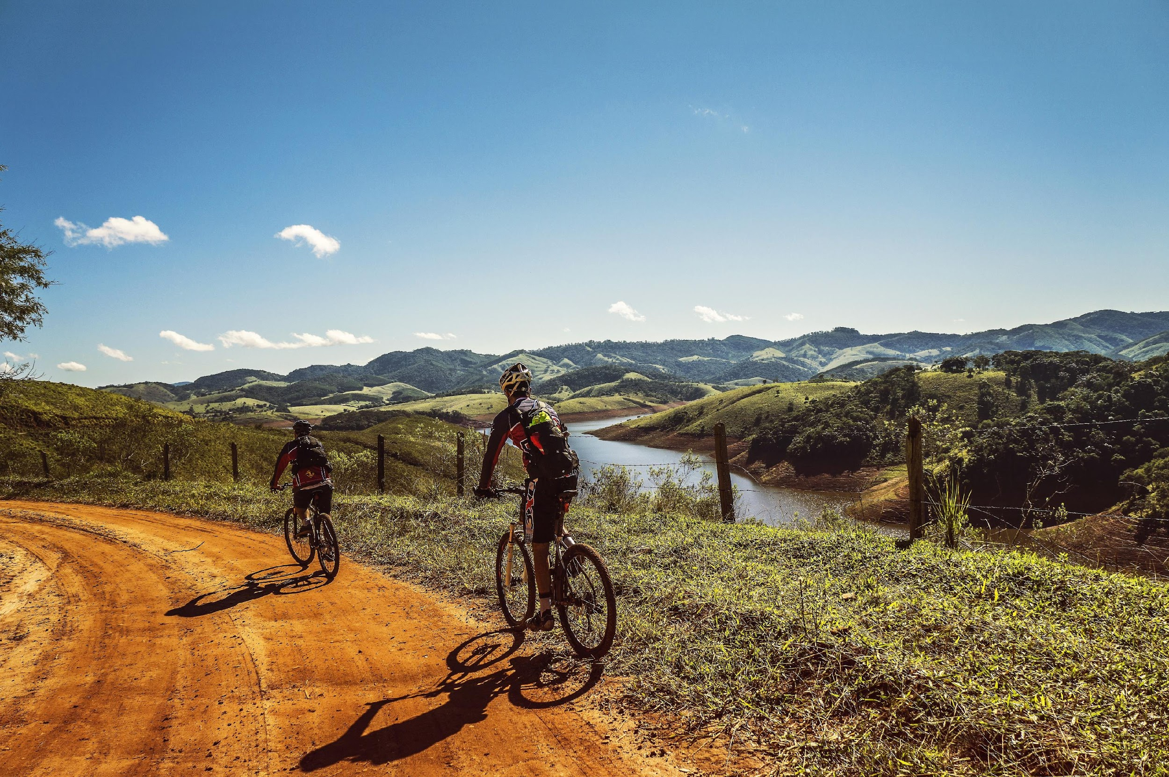
Thank
you!

